Slide 1

ROSY WELCOME

Slide 2
IDENTITY ENTITY
LESSON
TEACHER
MD.JAHANGIR ALAM
B.A(HONS),M.A
ASST. TEACHER
ISLAM NAGAR SAILAMPUR HIGH SCHOOL
NAKLA,SHERPUR
EMAIL-mjalam999@gmail.com
CLASS-8
SUBJECT-ENGLISH FIRST PAPER
UNIT-1
LESSON-9
SECTION-C
TIME-50 MINUTES

Slide 3
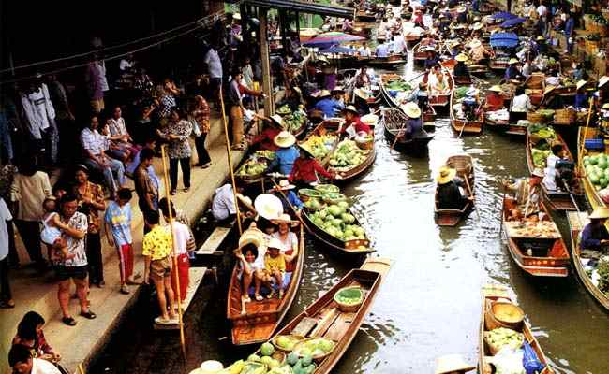
Now look at the following picture,please.
What is it ?
Then it is a .…..
floating market
Is it on land or on water?

Slide 4
THE THA KHA
FLOATING MARKET

Slide 5
OBJECTIVES
At the end of the session ss will be able to-
identify any floating market.
differentiate between a floating market and a general market.
describe the The Tha Kha Floating Market.

Slide 6
VOCABULARY
Word | Meaning | Sentence
traditional | Passing down of elements of a culture from generation to generation | We have our own traditional dress.
floating | afloating | I like floating flowers.
local | native | We are local here.

Slide 7
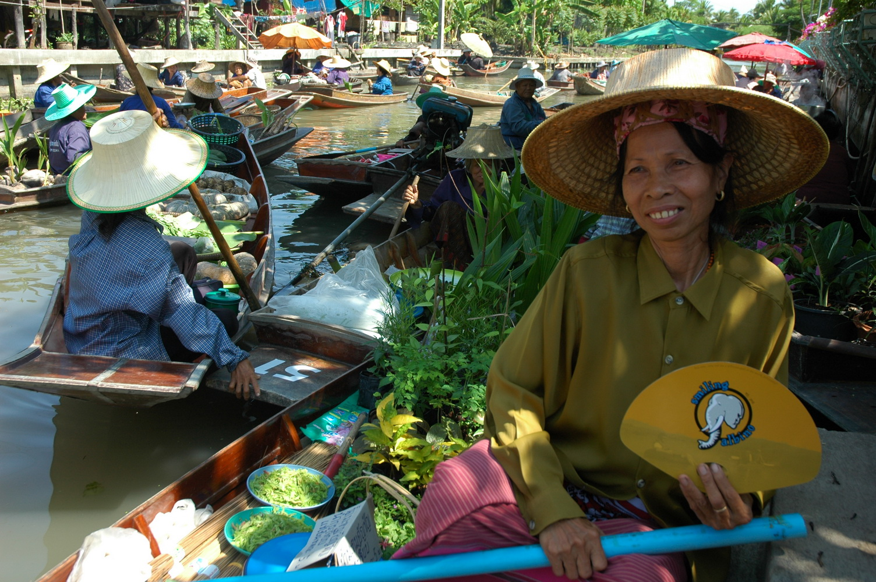
Now watch a video .
Now read through the passage silently.

Slide 8
PAIR WORK
Look at the above picture and talk about it in pairs

Slide 9
GROUP WORK
Point out the characteristics of ‘’The Tha Kha Floating Market’’
Now match your answer:
Characteristics of the market:
It is a traditional floating market.
It uses to sit only six or seven days a month.
The main buyers here are the Tha Kha natives.
The sellers are mainly elderly Thai women.
All are seen smiling and calling each other by name

Slide 10
EVALUATION
What is a floating market ?
Who are the main buyers here ?
Why are they busy for ?

Slide 11
HOMEWORK
Make a difference between ‘’a floating market’’ and ‘’a general market’’.

Slide 12

EVERYBODY THANKS

